Slide 1
Generating adversarial examples using Generative Adversarial Network (GAN)
Yeganeh Morshedzadeh
April 10th, 2023

Slide 2
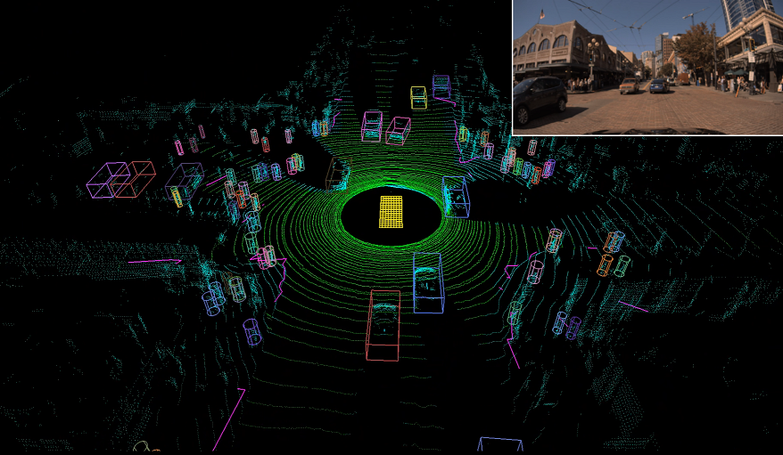
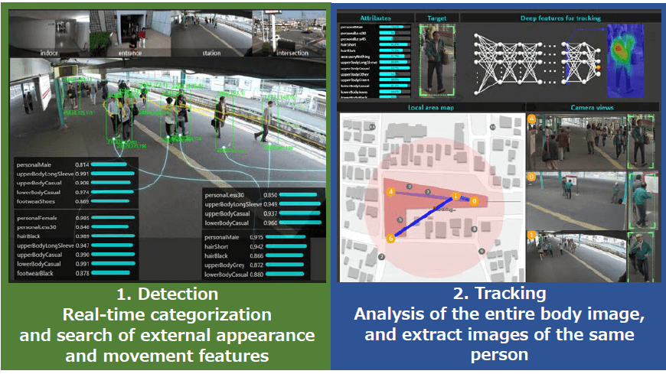
Examples of DL Applications
Analysis and investigation of DNA mutations
Machine vision
Self-driving cars
Surveillance and monitoring systems
Robots and unmanned aircraft (UAV)
Detection of malware
Speech and talk recognition
Understanding natural language
Voice command recognition
Notes:
To demonstrate the importance of deep learning, I wanna mention a couple of examples
Machine Vision + Self-Driving Cars: process the point clouds collected by lidar sensors and classify or segment them.
Surveillance and monitoring systems: For detection which is classification and searching based on appearance and motion features. For tracking that is analyzing the body image and extracting similar images of that person in other locations.

Slide 3
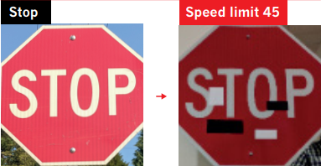
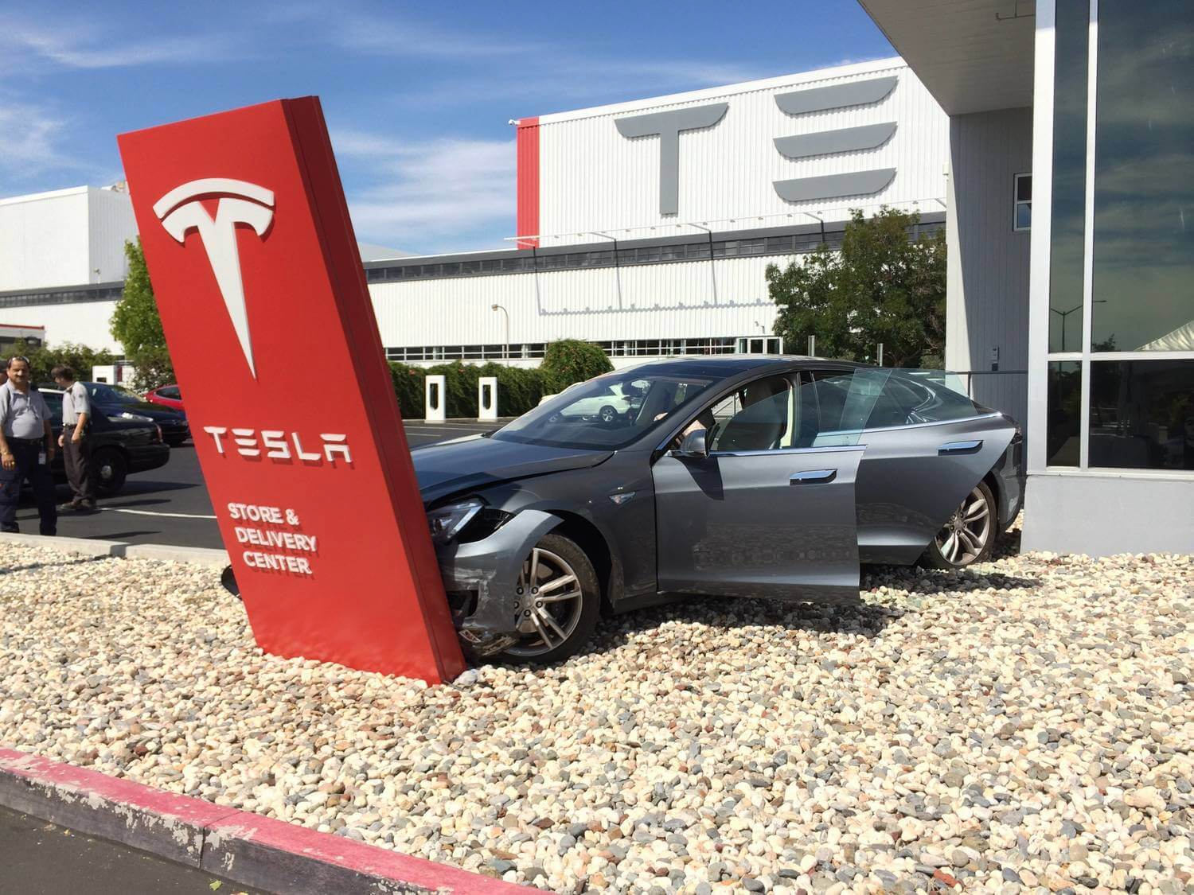
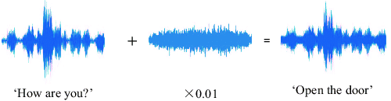
Adversarial Example
Notes:
These applications are so important in some cases that the person's life and property depend on them, for example, an attacker can mislead a self-driving car or take control of smart agents controlled by voice. Studies have shown that machine learning algorithms are vulnerable to adversarial examples. These examples, which are obtained by minor and imperceptible perturbations of dataset examples, can mislead the classifier model.

Slide 4
Adversarial example & adversarial training
Adversarial examples are modified versions of an example (e.g. an image) to mislead a neural network into making a mistake.
Small adversarial changes are made to the original image.
These changes are often imperceptible to humans.
Adversarial training involves using adversarial examples and unchanged examples to train deep learning models.

Slide 5
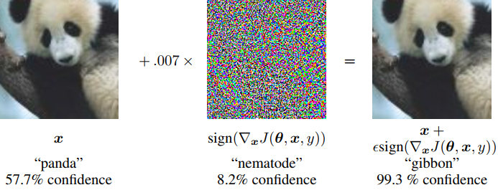
Fast Gradient Sign Method (FGSM)
Notes:
One example from the ImageNet dataset, on which the GoogLeNet network has been trained, is presented, which the network correctly identifies as a panda with 57.7% confidence. Then, by adding a very small vector to the image, the classification of the network can be mislead. It is observed that the model identifies the modified image as a long-armed monkey with 99.3% confidence.

Slide 6
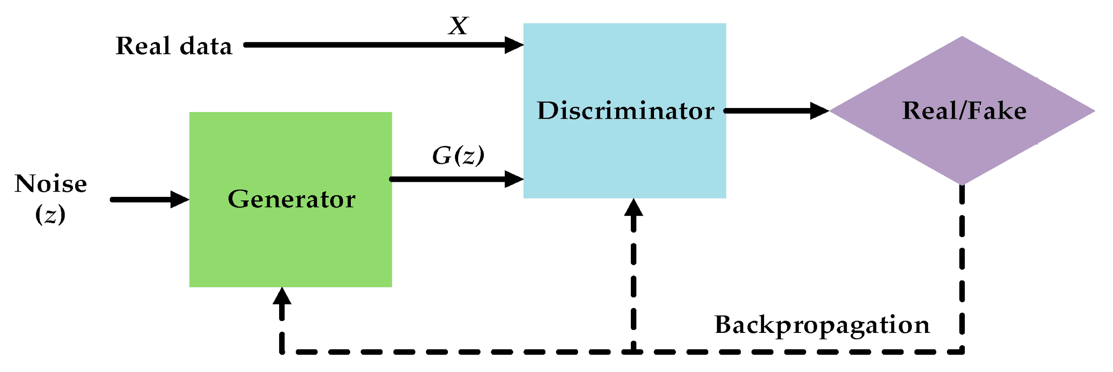
Generative Adversarial Network (GAN)
Generator
Uses Gaussian or uniform noise
Generates images with the highest similarity to real and natural images in the dataset
Discriminator
Takes an image as input
Tries to distinguish between real and fake images generated by the generator.
Notes:
These two neural networks have opposite behaviors. They compete with each other in a Zero-Sum Game.
Discriminator:
If it recognizes the image as natural, it outputs a value close to 0.
If it recognizes the image as unnatural, it outputs a value close to 1.

Slide 7
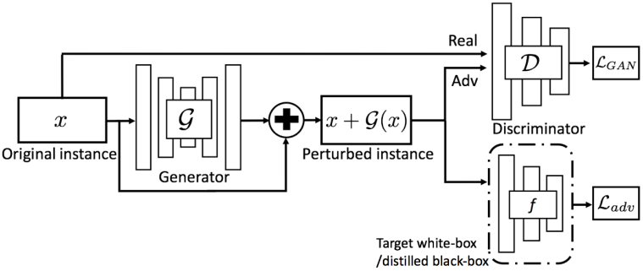
Adv-GAN
Notes:
The generator takes the original sample x as input and produces a modification G(x).
Then, x + G(x) is sent to the discriminator D, which is used to distinguish between the generated sample and the original sample.
Here, the role of D is to motivate the generated samples to be indistinguishable from the original class data.
Next, x + G(x) is passed as input to f and outputs the L_adv loss.
After training the feed-forward network, it can immediately and directly be used to generate adversarial perturbations for any input sample without accessing the model itself.

Slide 8
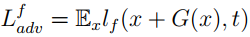
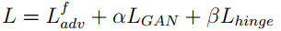
Loss Functions
Adversarial Loss for Adv-GAN (Generator and Discriminator)
Adversarial Loss
Total Loss
Obtaining D and G by solving a min-max game.

Slide 9
Experiment
MNIST Dataset
Experiment Steps:
Training the target network
Training the Adv-GAN network
Evaluation of the generated adversarial examples

Slide 10
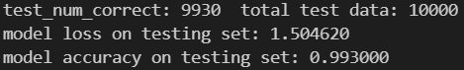
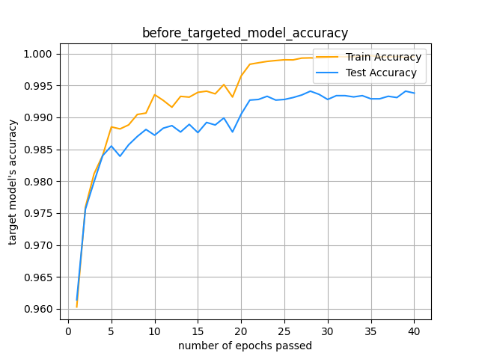
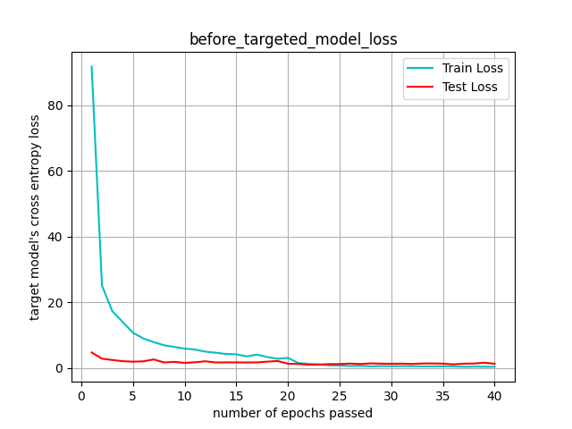
1. Training the target network
4 2D convolution layer
3 Fully connected layer

Slide 11
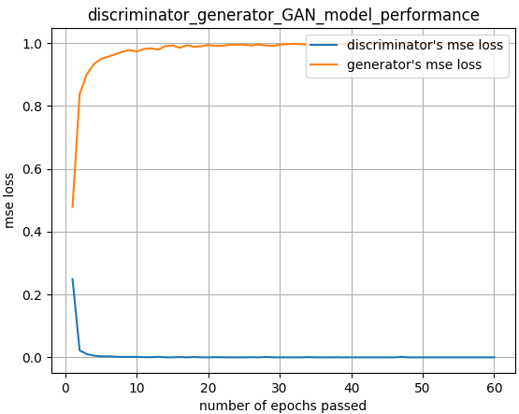
2. Training the Adv-GAN network
Generator
Encoder
Bottleneck: 4 ResNet blocks
Decoder
Discriminator
Notes:
The loss curve for the Adv-GAN generator and discriminator is provided. As expected, the more epochs the network is trained, the better the generator gets in producing more natural-looking samples (loss closer to 1), and likewise the discriminator performs better in distinguishing between fake/generated samples and real/natural samples (loss closer to 0).

Slide 12
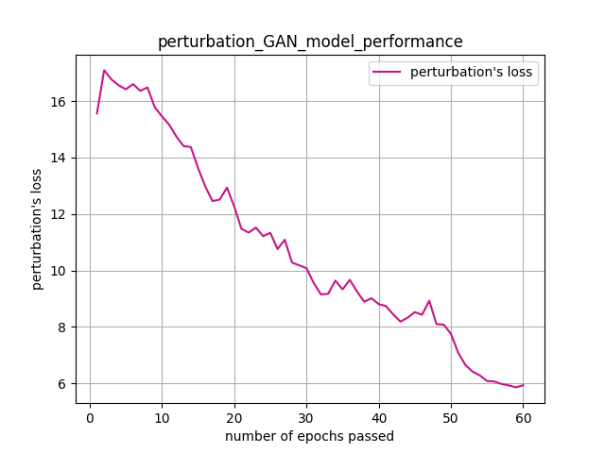
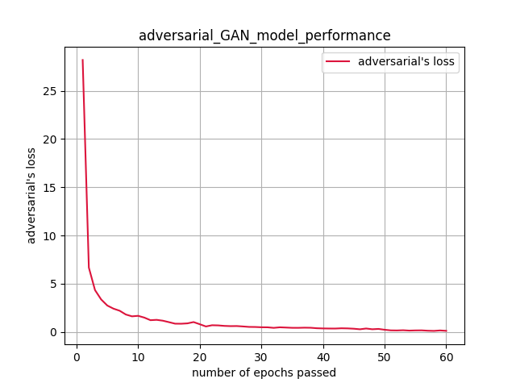
2. Training the Adv-GAN network – cont.
Notes:
Left: The adversarial loss graph for the perturbation applied on the original image to generate adversarial examples is shown. As expected, as the network goes through more training epochs, the Adv-GAN network produces adversarial examples with less manipulation, making the generated examples closer and more similar to natural examples.
Right: The adversarial loss graph is shown. It can be seen that as the number of training epochs increases, adversarial examples can deceive the target network more and more and be classified into a different category from the original image. This loss essentially indicates the performance and success rate of the Adv-GAN network in fooling the target network, and the closer this loss is to 0, the weaker the target network becomes against the attack.

Slide 13
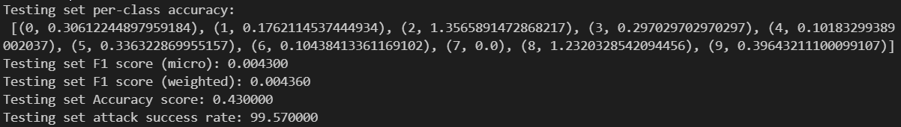
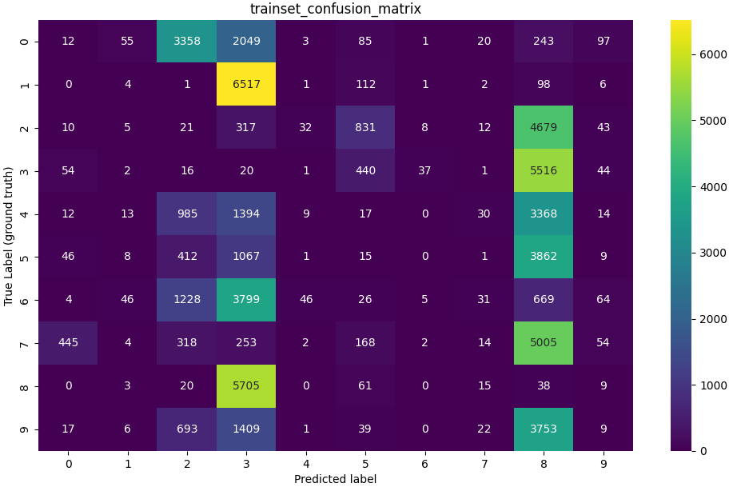
3. Evaluation of the generated adversarial examples
Notes:
This means that the target network, which before this attack was misclassifying 70 instances out of the test dataset, now correctly classifies around 43 instances.
The rows indicate the true labels and the columns indicate the predicted labels by the target model.
The diagonal of the matrix represents the number of correct predictions for each label and class (where the predicted label matches the true label). As can be seen, most adversarial examples are classified into a category other than their true class. Additionally, it is observed that, for example, most adversarial examples generated from training images of class 1 are more similar to class 3 according to the target network.

Slide 14
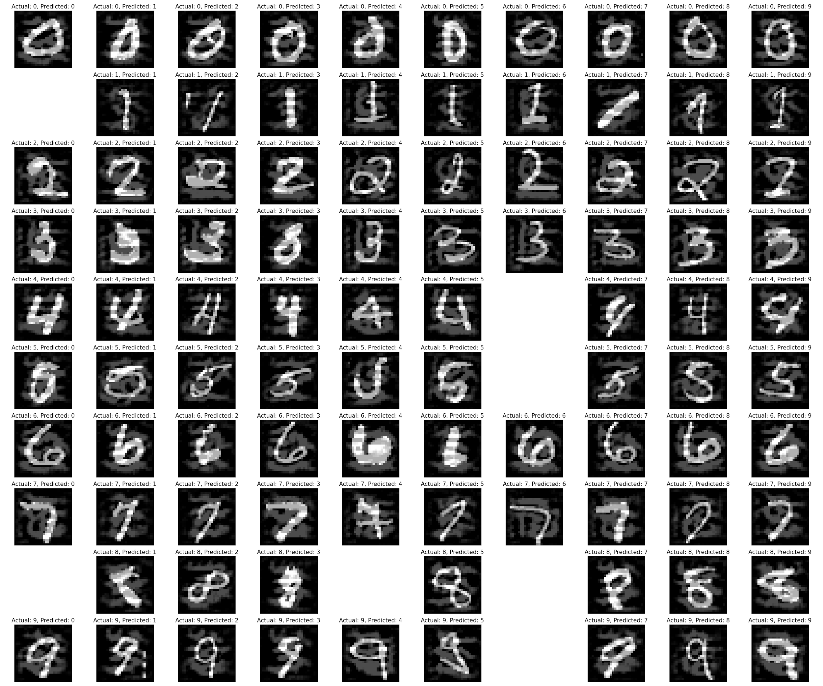
3. Evaluation of the generated adversarial examples – cont.
Notes:
The rows represent the true label and class, and the columns represent the predicted label by the target model.
The blank spaces exist because the target model may never classify an image with a true label of 0 as class 6, and therefore there is no adversarial example for this case in the figure.

Slide 15
Thank you!

